Slide 1
RADV Risk Adjustment Data Validation Tool
FHIRed UP
Augusto Burgos aburgos3@gatech.edu Spiro Ganas spiroganas@gmail.com Anja Guillory anjag1993@gmail.com Jamie Richgels jrichgels3@gatech.edu Daniel Stoneburner dstoneburner3@gatech.edu Tala Suidan tmsuidan@gatech.edu

Slide 2
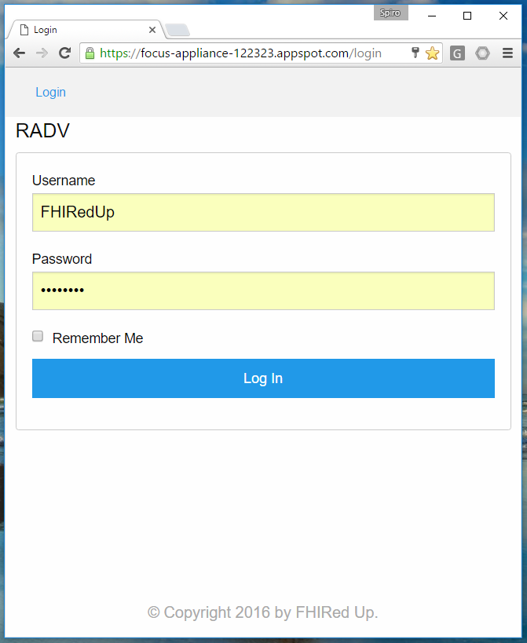
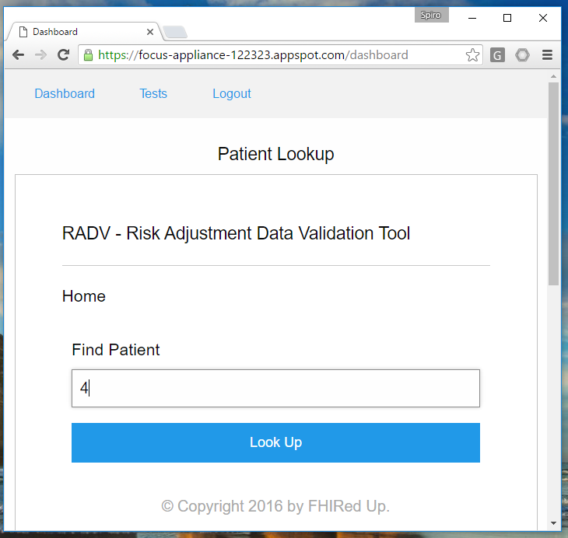

Slide 3
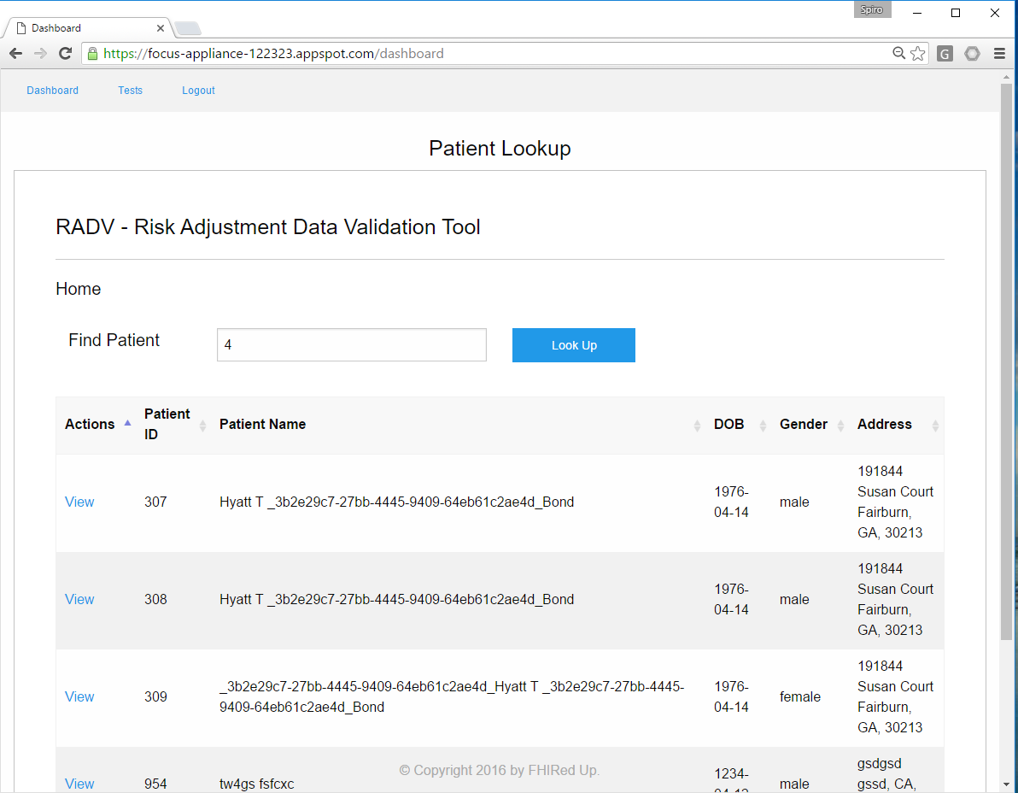

Slide 4
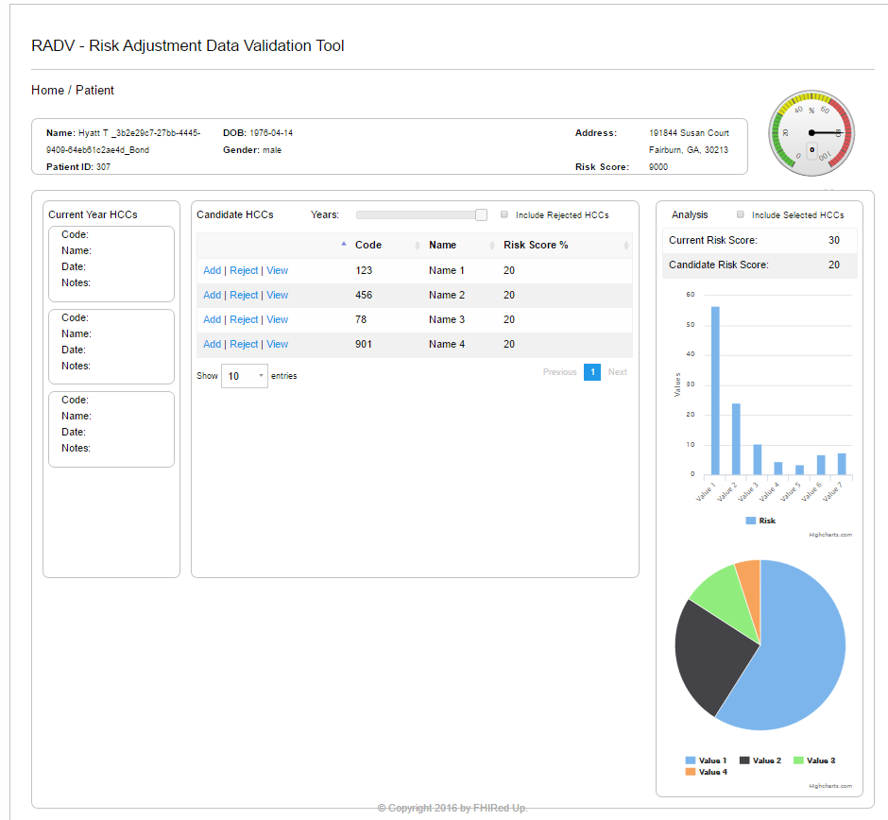

Slide 5
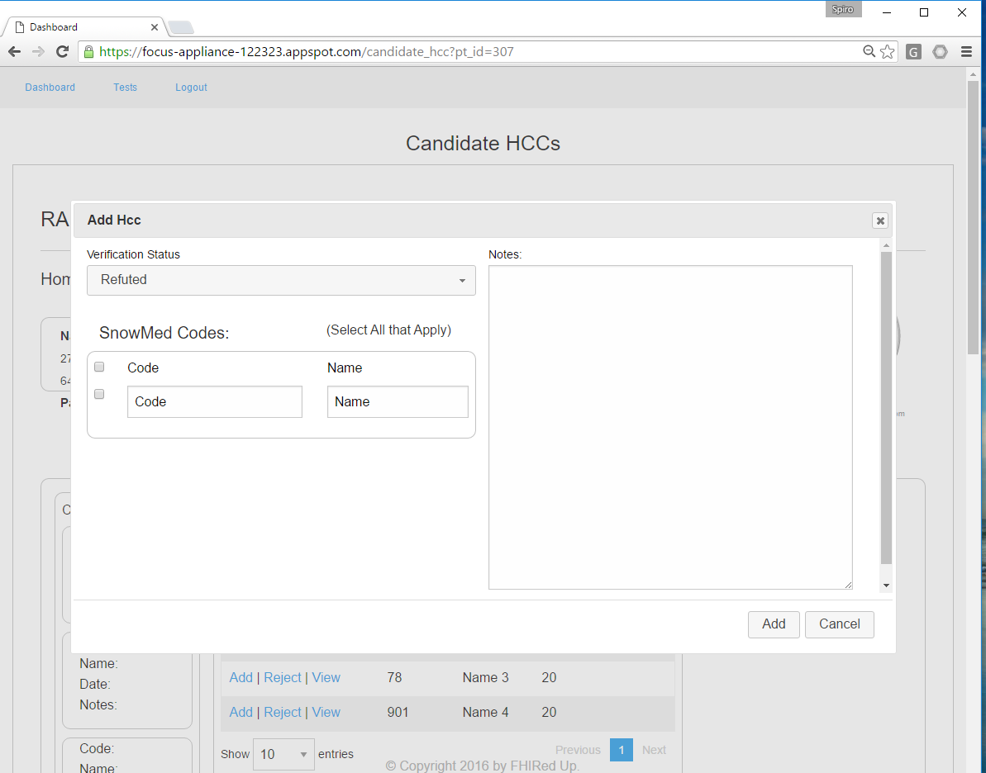

Slide 6
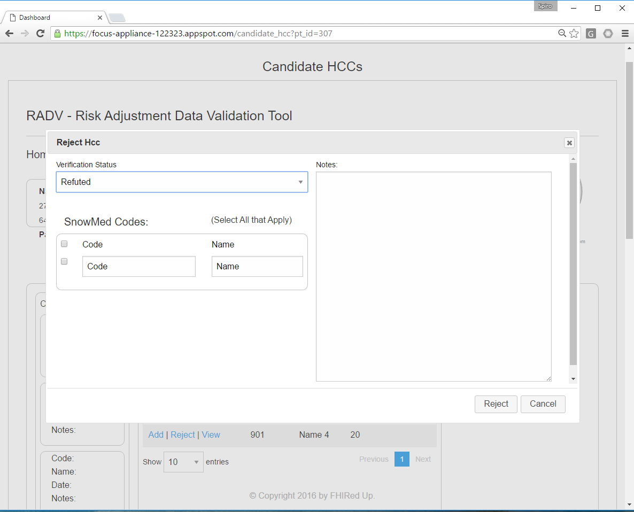

Slide 7
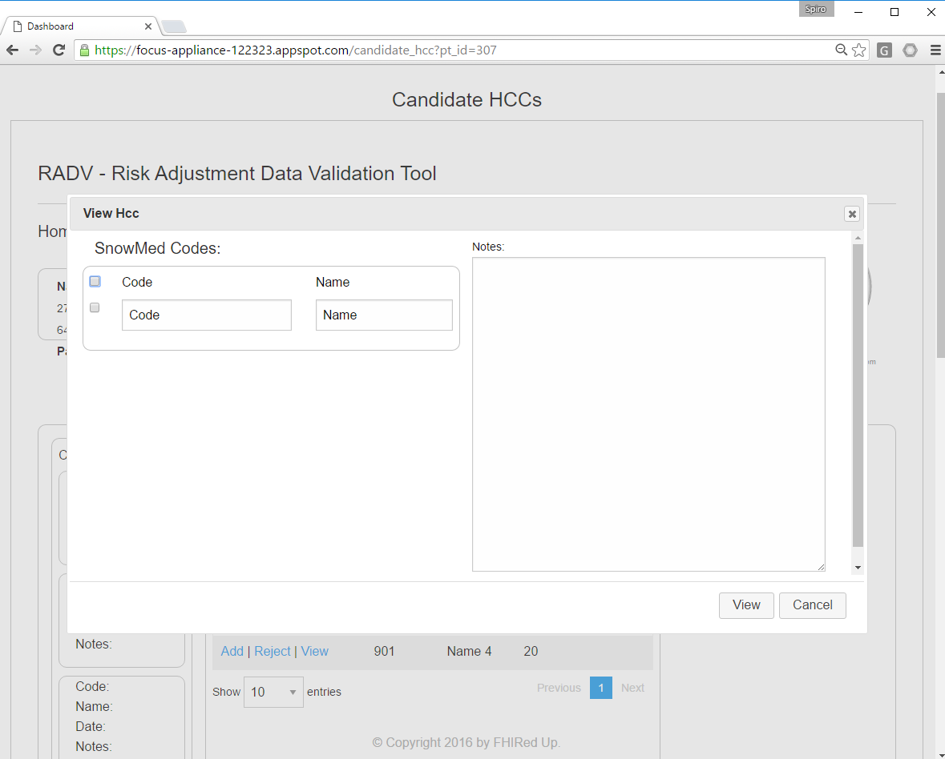

Slide 8
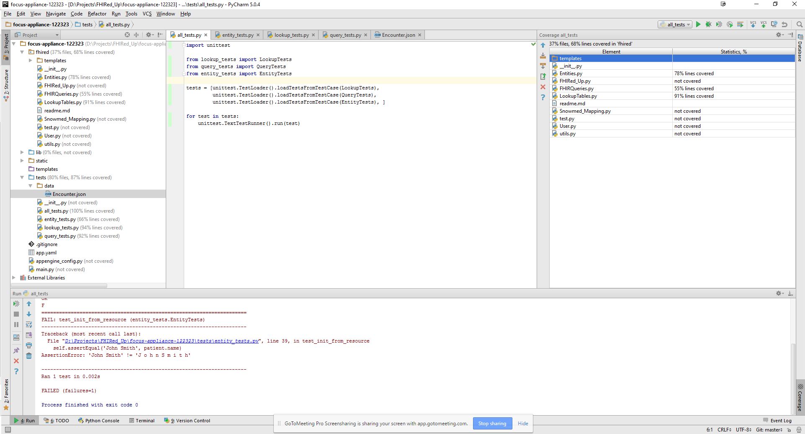
QA Testing

Slide 9
Updated Gantt Chart
* All team members involved † - Developers and testers involved ‡ - Business Analysts involved
Milestones and tasks in purple and dark blue are complete. Remainder are in progress or in the future
Notes:
Items to discuss:
This slide presents an updated Gantt chart
Scope is set until we ensure we make the most of its current reach.
The 3 2-week sprints are complete thanks to Augusto, Spiro, and Anja. The 4th is underway with a final 1 week spring to correct any remaining bugs.
Analysis is complete
Code testing is occurring on a continual basis by Dan and other team members.
Documentation has started and will be completed a week after the 4th sprint.

Slide 10
Concerns & Other Issues

Slide 11
References

